Slide 1

Making roads better
Transport Technology Forum

Slide 2
Making roads better…..

Slide 3

Background
Transport Technology Forum formed in early 2015
Senior cross sector engagement and leadership
Driving road transport forward
Innovation
Investment and Funding
Co-operation
Collaboration
Various Working Groups tackling key areas
Papers published or being published
Specifically a WG focused on Co-operative Vehicles (C-ITS) and roads, and inc, Standards and Deployment

Slide 4
New demonstrations
CCAV projects
C-ITS projects
T-TRIG projects
Network managers
Government (DfT , Innovate UK and CCAV)
Identify from projects key outcomes, gaps and opportunities
Disseminates key guidance to practitioners and industry
Forum
Highlights network management needs and gaps, links customers with suppliers, informs on opportunities, helps projects form
Network management Suppliers
Automotive industry
Comms industry

Slide 5

Investors
Workplan delivery
Government
Authorities
Industry = the Forum
Academia
Adjacent industries/sectors
Advisory Board
Enhanced procurem’t
Connected vehicles and road operation
Developing innovation
Stakeholder
engagement
Network
Operator
User Group
Joint working with other groups, including
AESIN
BPA
Strategic
business case
Specifications
and standards
Exports

Slide 6
Network Operator User focus
Public sector adoption and use of technology
Developing confidence and efficiency in deployment of technology
common requirements
sharing knowledge and risk
promoting critical R&D
developing and sharing skills
engaging collectively with the supply chain.
encouraging “follower” authorities
Regional subgroup
Coming soon set of roadshows
Informed by today

Slide 7
What have we done?

Slide 8
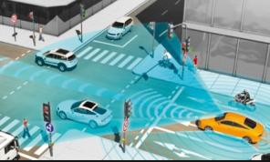
Signals - we took a Scenario
An Authority has heard about “C-ITS” , but isn’t aware or cannot quantify the benefits, however must future proof plans and investments via robust procurement.
Additionally they:
..are keen to adopt new ideas that support policy
and save money, but cannot be “bleeding edge”
…cannot make overnight changes so will need to
change equipment in phases
…are concerned by the mainstream “noise” about Automated Vehicles but need to know what it really needs to do and when!
…and how does this relate to current data being produced and managed

Slide 9
LA’s Problems to Solve
Core Traffic Management Act Statutory Duty
An oversaturated network peak that causes congestion and restricts economic growth
Elected members, press and business all want better journeys
Emissions that worry Elected Members, yet size of the problem is unknown
Parking is an issue for stakeholders
Better bus services are an aspiration on key corridors
Ageing equipment on street is an issue
The Authority has some capital spend but little revenue
Only 2 full time staff

Slide 10
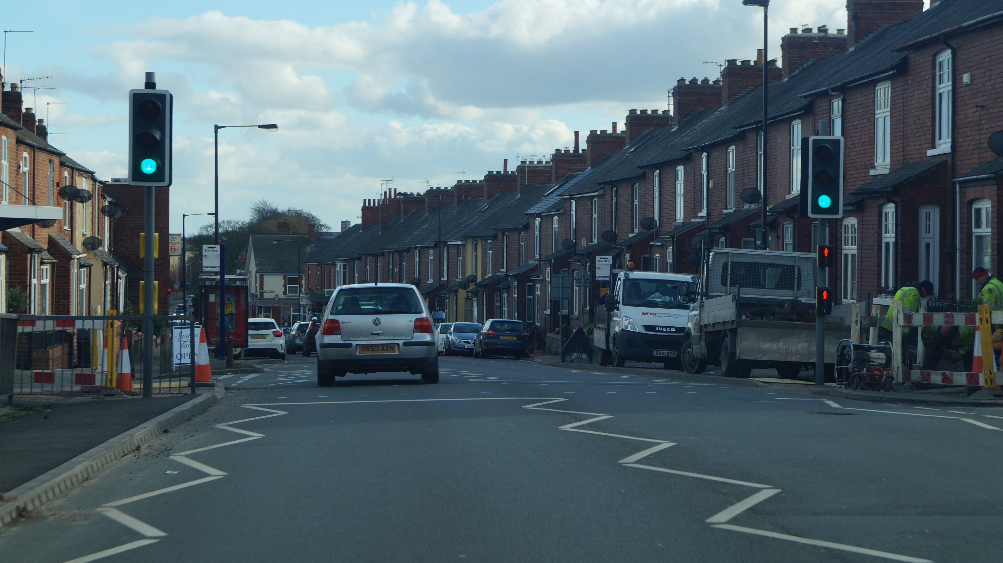

Slide 11
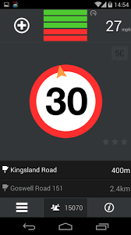


We considered signals focused C-ITS tools that LAs need to be concerned about
Signal Phase and Timing (SPaT)
Green Light Optimal Speed Advisory (GLOSA)
Co-operative priority

Slide 12
Benefits of SPaT / GLOSA aren’t widely recognised/ measured
Heads up of traffic light change
Safety, more time to react
Reduction in stop start through smooth constant driving
Less emissions
Less fuel
Less wear and tear
Less noise
Better perception of journeys
Better perception that authorities are doing their job
Information for future autonomous vehicles
Not much data
Large potential for “creative ideas”

Slide 13
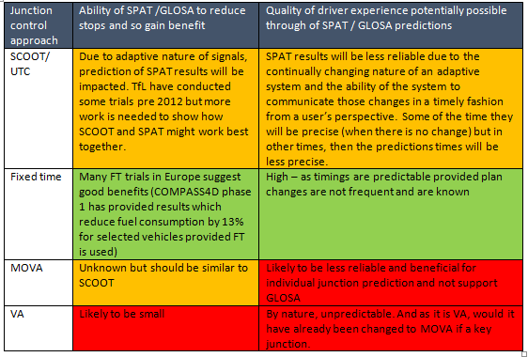
Question: Should SPaT /GLOSA be deployed for all junctions?

Slide 14
SCOOT vs GLOSA then!
Tension between investment and expectation
Fixed time plus GLOSA being demoed
Some SCOOT work (TfL) showed promise
Need for research and deployment
Ability for UK industry to lead

Slide 15
Question: What do LAs need to be aware of when considering C-ITS and traffic signal operation.
Looking at the links in the chain for SPaT, we looked at the use of standards and the implications.
Made a list of research areas
Working with DfT to shape programme
UTMC. UDG etc
What don’t you know?

Slide 16
Other areas
Guide for Local Authorities on C-ITS
Practical guidance
Business case for deployment of technology
Shared data
UK business case
ITS G5 / LTE / 5G
Which one…
Separate Paper Available
Coming soon…
Position on “Connected……… and Autonomous vehicles” and roads
Bring roads operations view to the table
38 million vehicles , 7.9 years ….
Connections with parking and automotive
Worlds are colliding…..

Slide 17
Conclusion
Las and Industry is raising awareness of the practicalities of C-ITS and Signals
No –one else will…
Sky isn’t blue
Barriers for mass market adoption being addressed
Full benefits of C-ITS and signals still need to be quantified
Further research and deployment needed – what don’t you know?
C-ITS needs to be about connected

Slide 18

